Slide 1

Development of Digital Pulse Emulator
Group Members
Muskaan Gupta
Simran Koul
Ayush Suri
Vishal Kothari

Slide 2


Acknowledgement
Internal Guide : Mr. Gopal Sonune Sir
External Guide : Mr. Jaydeep Gore Sir

Slide 3
AGENDA
Problem Definition
Scope
Software/Hardware Requirements
Literature Survey
Proposed System
Design of Proposed system(Use case Diagram)
Implementation
What we will do next ?
References

Slide 4
Problem Definition
Reality :
“Information is the oil of the 21st century, and analytics is the combustion engine.”
Problem:
Testing is challenging for large scale data acquisition system

Slide 5
SCOPE
SCOPE
Development of digital pulse emulator
Data that needs to be analyzed and probed will be considered
Involves developing routines in C
Input: Probability and amplitude spectrum
Output: Generation of pulses
Solution

Slide 6
SOFTWARE REQUIREMENTS
Xilinx Vivado
Gcc compiler
HARDWARE REQUIREMENTS
Zynq development board with FMC connectors
High speed data acquisition
FMC card with on board two analog inputs and outputs
Power supply adapter

Slide 7
Literature Survey
Configurable Digital Emulation of Radiation Sources
[Abbiati, Sebastiano Scarpaci, Angelo Geraci, Giancarlo Ripamonti
2009 IEEE Nuclear Science]
Output of the FPGA device enters an analog front-end that plays the role of a classic preamplifier.
In this way, the system actually can emulate the cascade of source, detector and preamplifier section.

Slide 8
Literature Survey
Occurrence time values that occur according to an assigned statistic distribution.
Multichannel Digital Emulator of Radiation Detection Systems
[J.Millman, A.Grabel, Microelectronics&quot;, McGraw-Hill, 198]
The performances of the instrument mainly depend on a good pseudorandom generation process.

Slide 9
Literature Survey
In order to test the realized LFSR statistic generator, different realizations of streams of pseudorandom values have been extracted from the FPGA.
In order to verify uniformity and independence of the generated values, chi-square tests have been performed.

Slide 10
Literature Survey
FPGA-based random pulse generator for emulation of a neutron detector system in a nuclear reactor.
[Abbiati, Sebastiano Scarpaci, Angelo Geraci, Giancarlo Ripamonti
2009 IEEE Nuclear Science]
A Fast, Programmable, Stand-Alone Pulse Generator Emulating Spectroscopy Nuclear Events
[J.Millman, A.Grabel, Microelectronics&quot;, McGraw-Hill, 198]

Slide 11
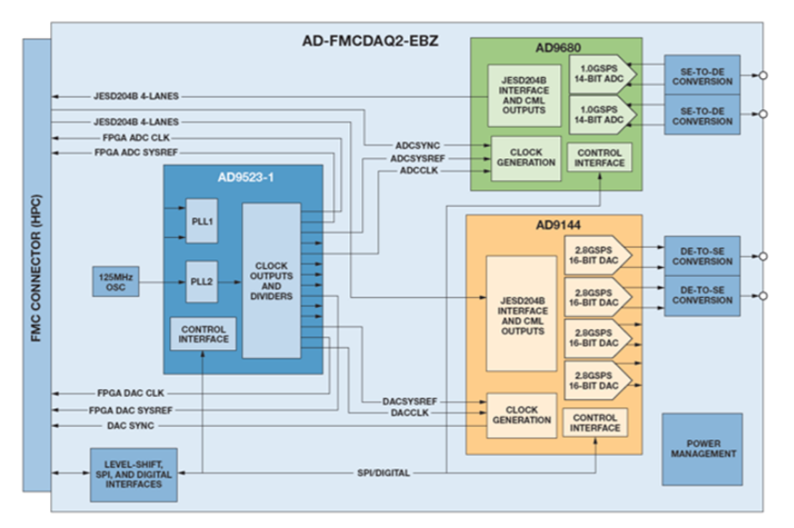
Proposed System

Slide 12
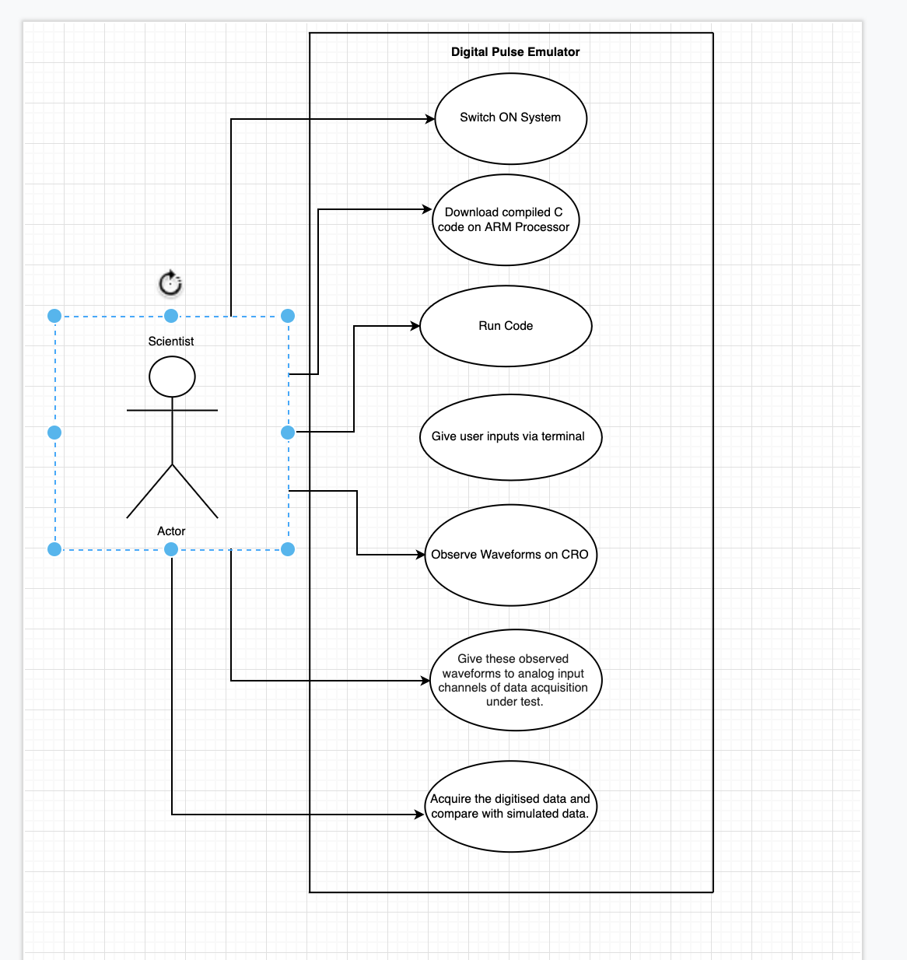
Design of Proposed System

Slide 13
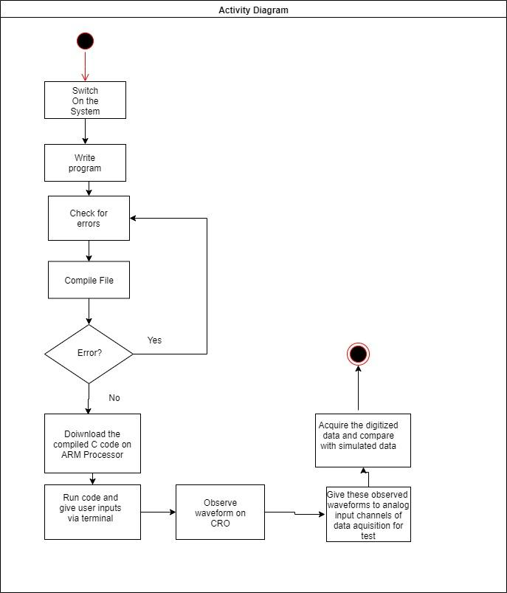
Activity Diagram

Slide 14
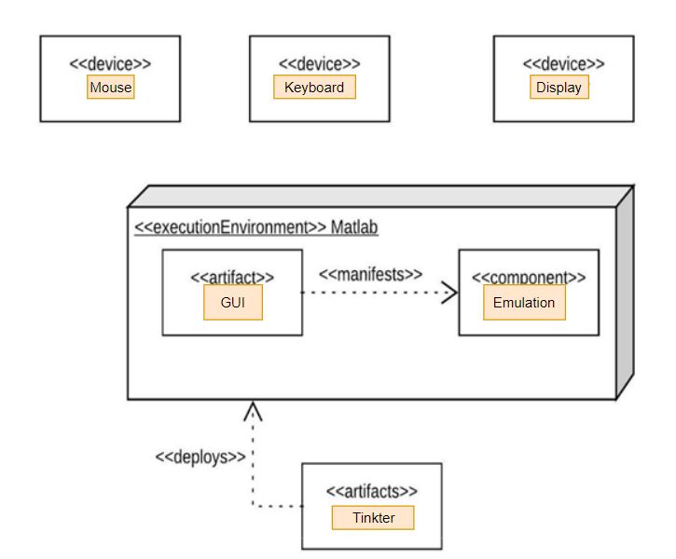
Deployment Diagram

Slide 15
Implementation
Drive Link
https://drive.google.com/drive/folders/1hHNOQVkdC4wC8A_7jJK6jPLPAvFuIax1?usp=sharing
Tools used
GCC Compiler, Python3, Tkinter GUI Tool and Matplotlib

Slide 16
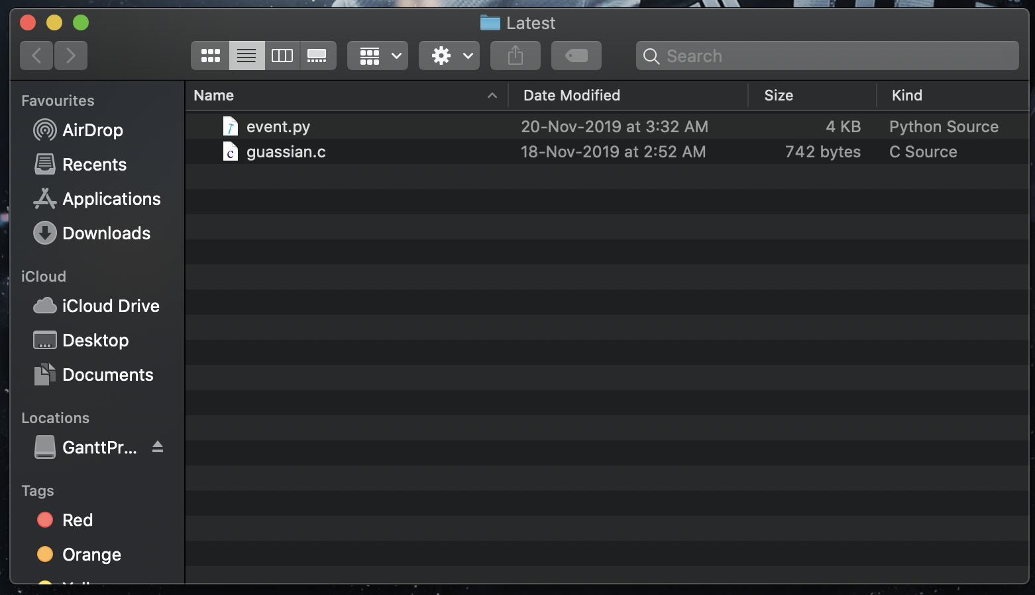
Output

Slide 17
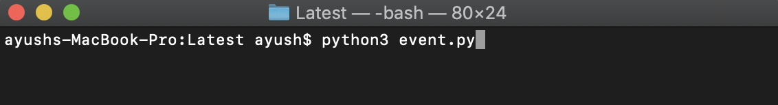
Output

Slide 18
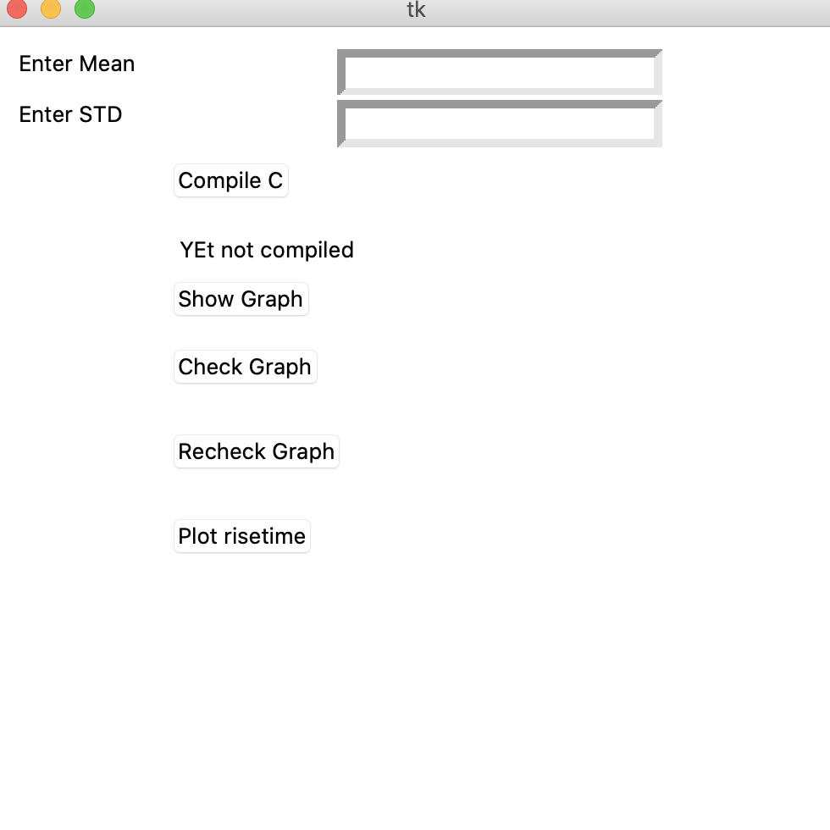
Output

Slide 19
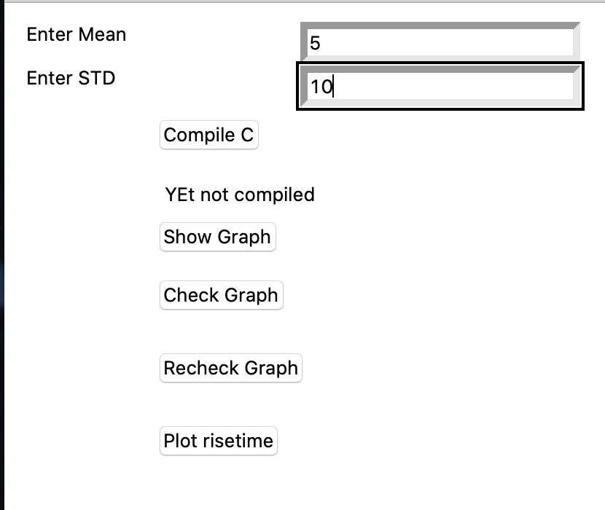
Output

Slide 20
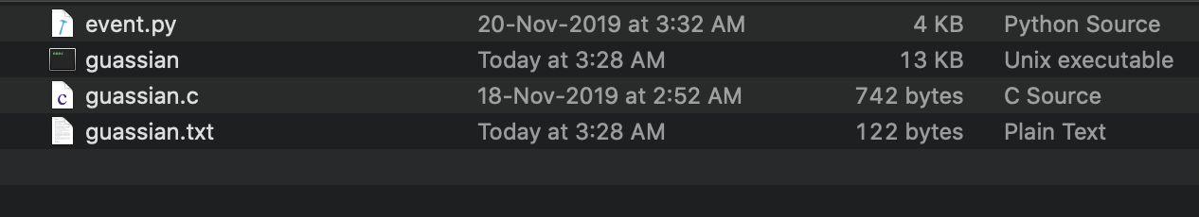
Output

Slide 21
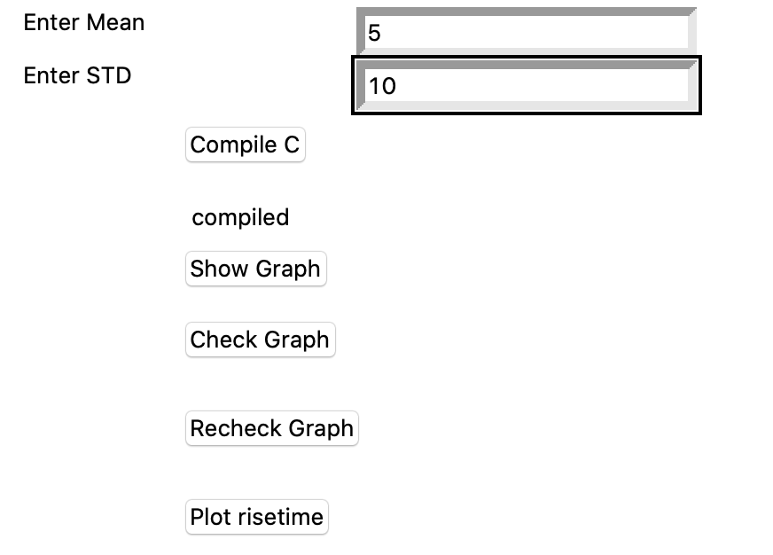
Output

Slide 22
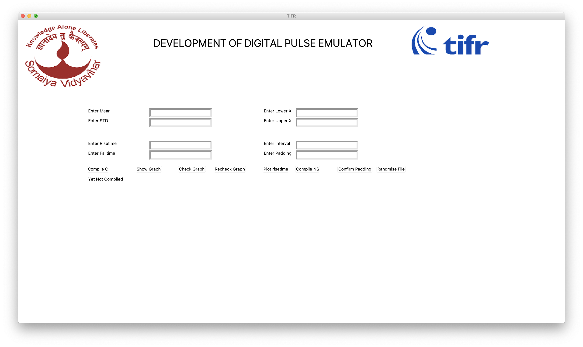

Slide 23
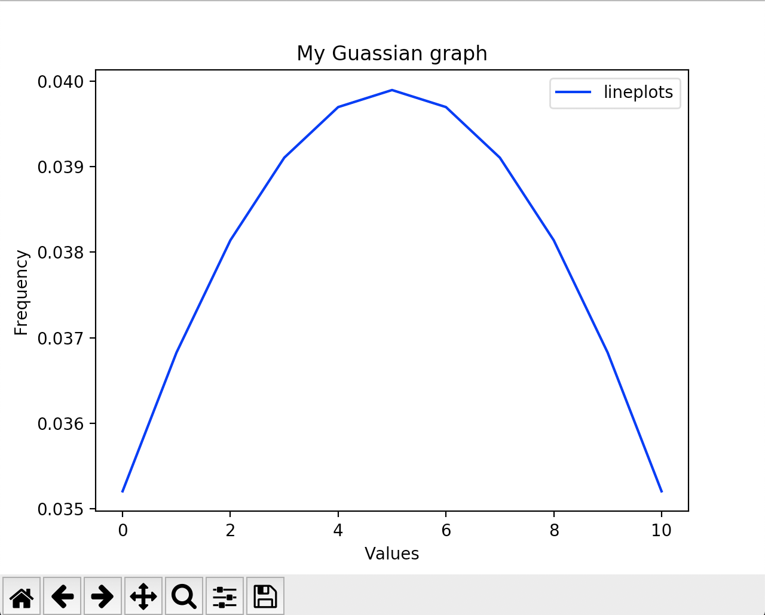
Output

Slide 24
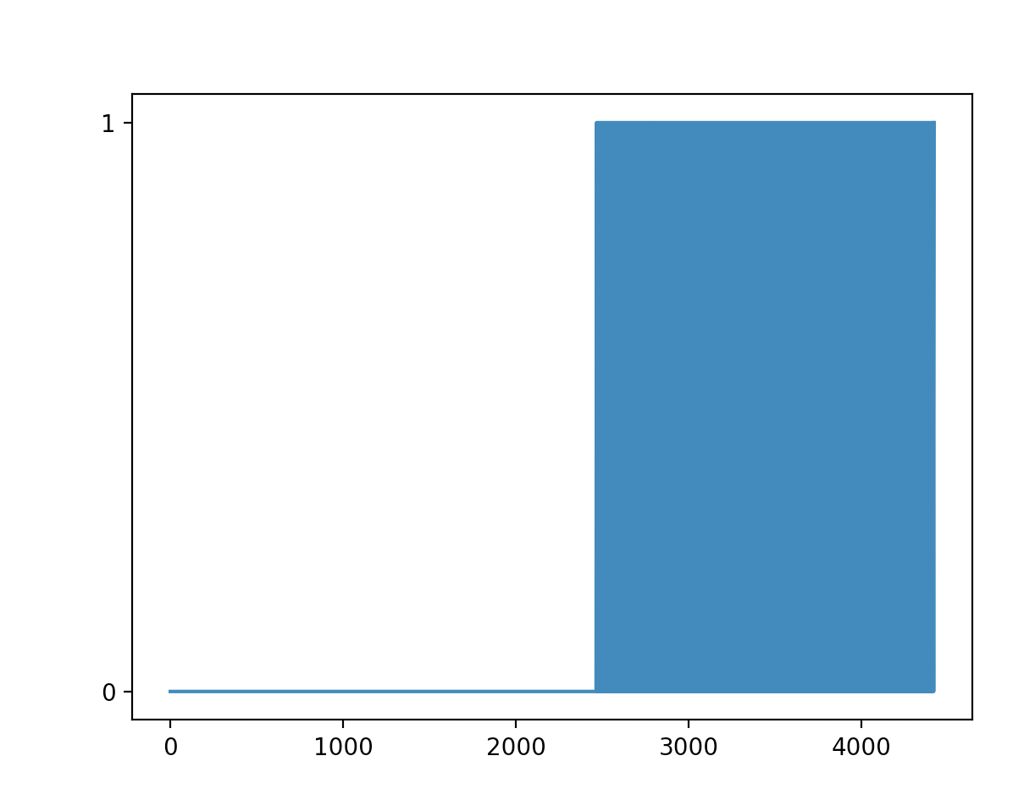
Output

Slide 25
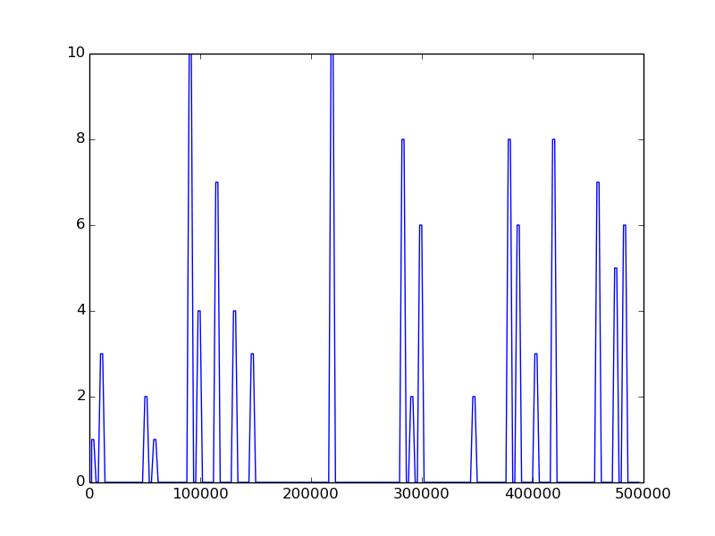
Amplitude spectrum

Slide 26
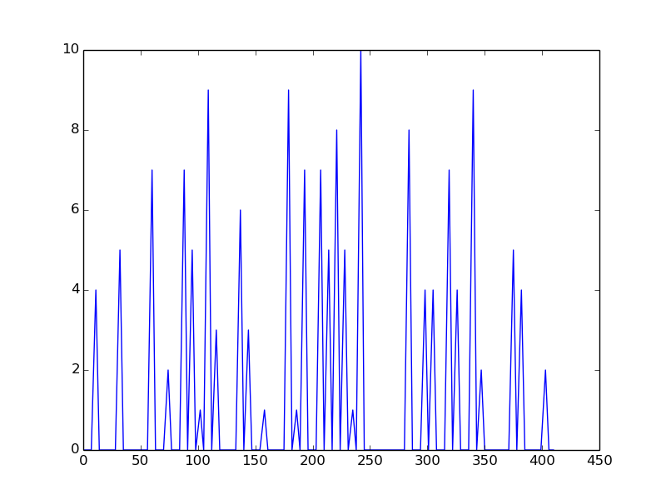
Amplitude spectrum

Slide 27
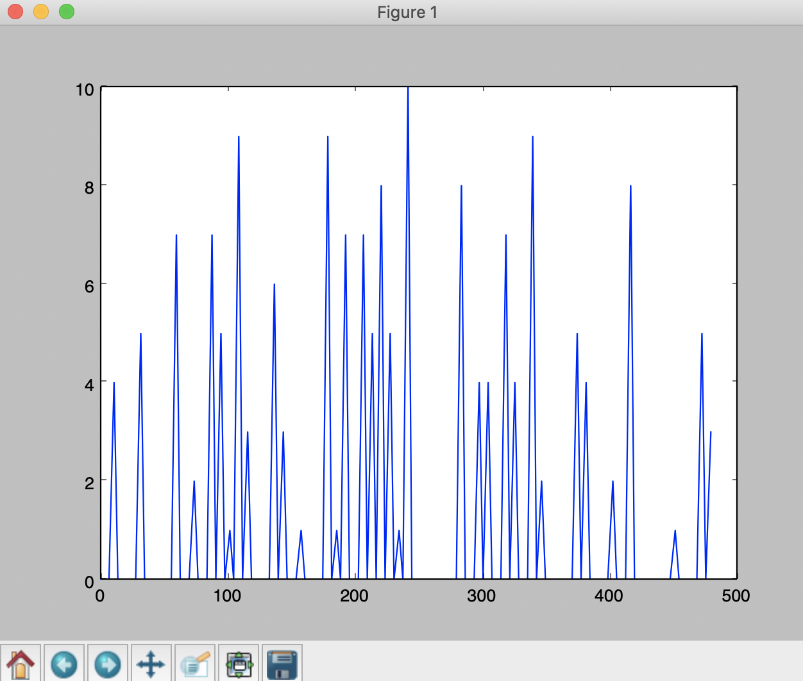
Amplitude spectrum

Slide 28
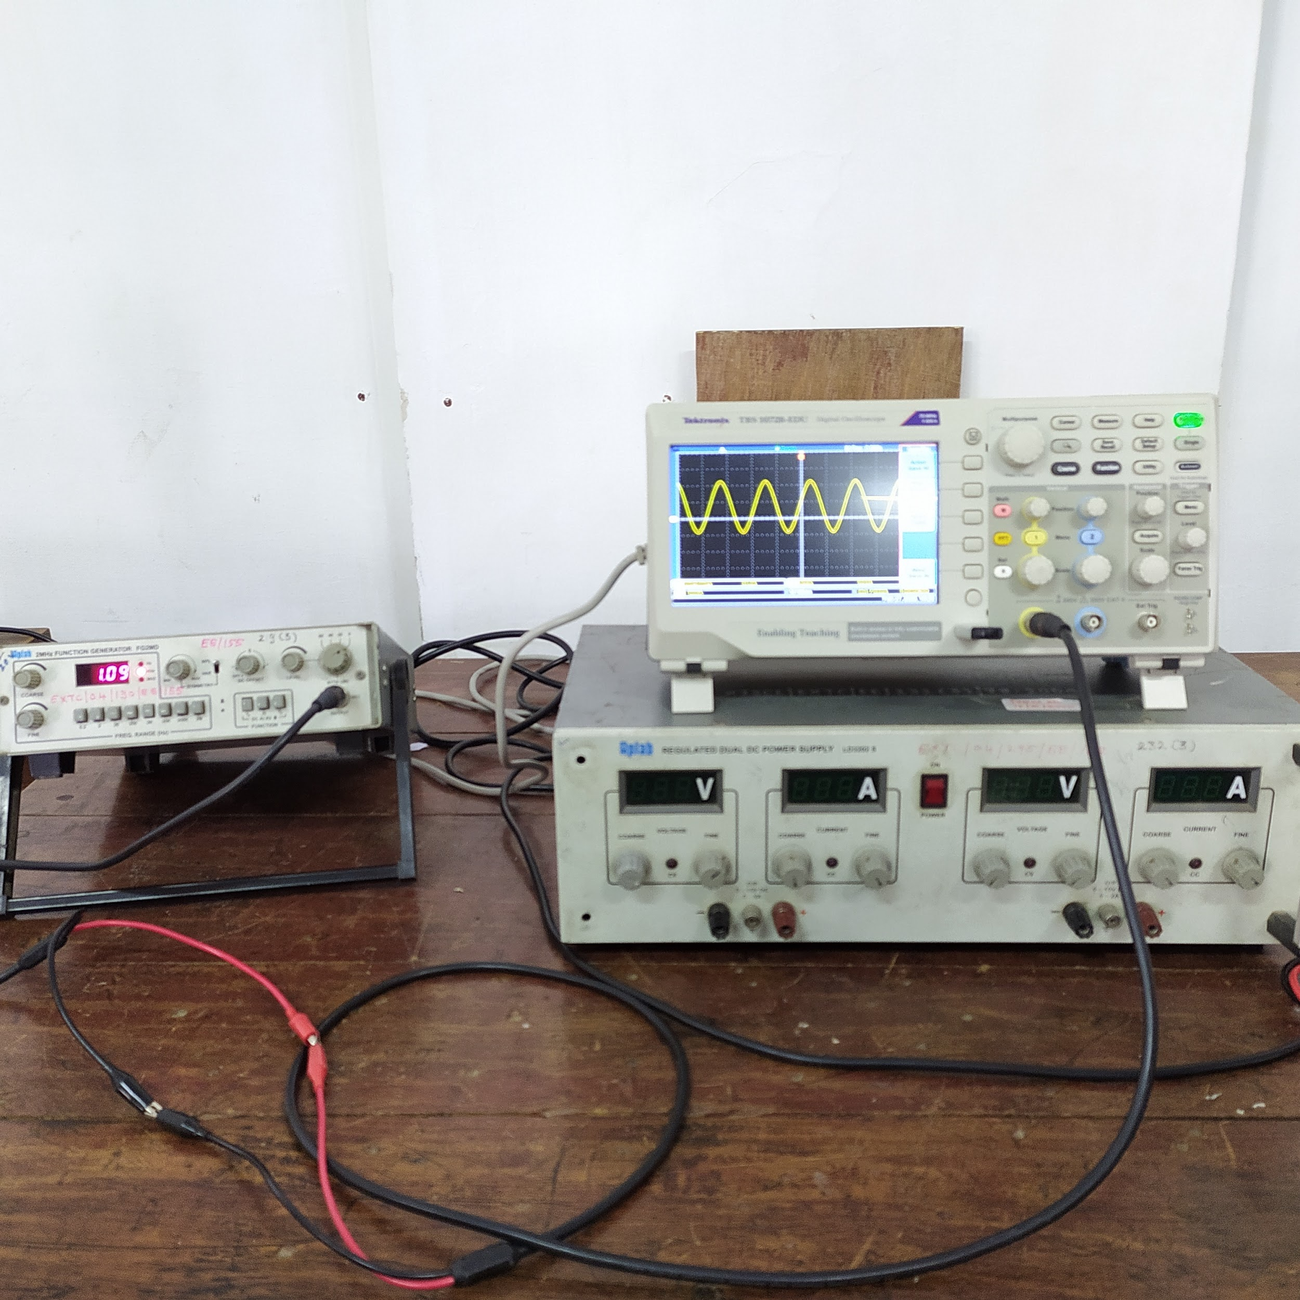
Hardware Implementation

Slide 29
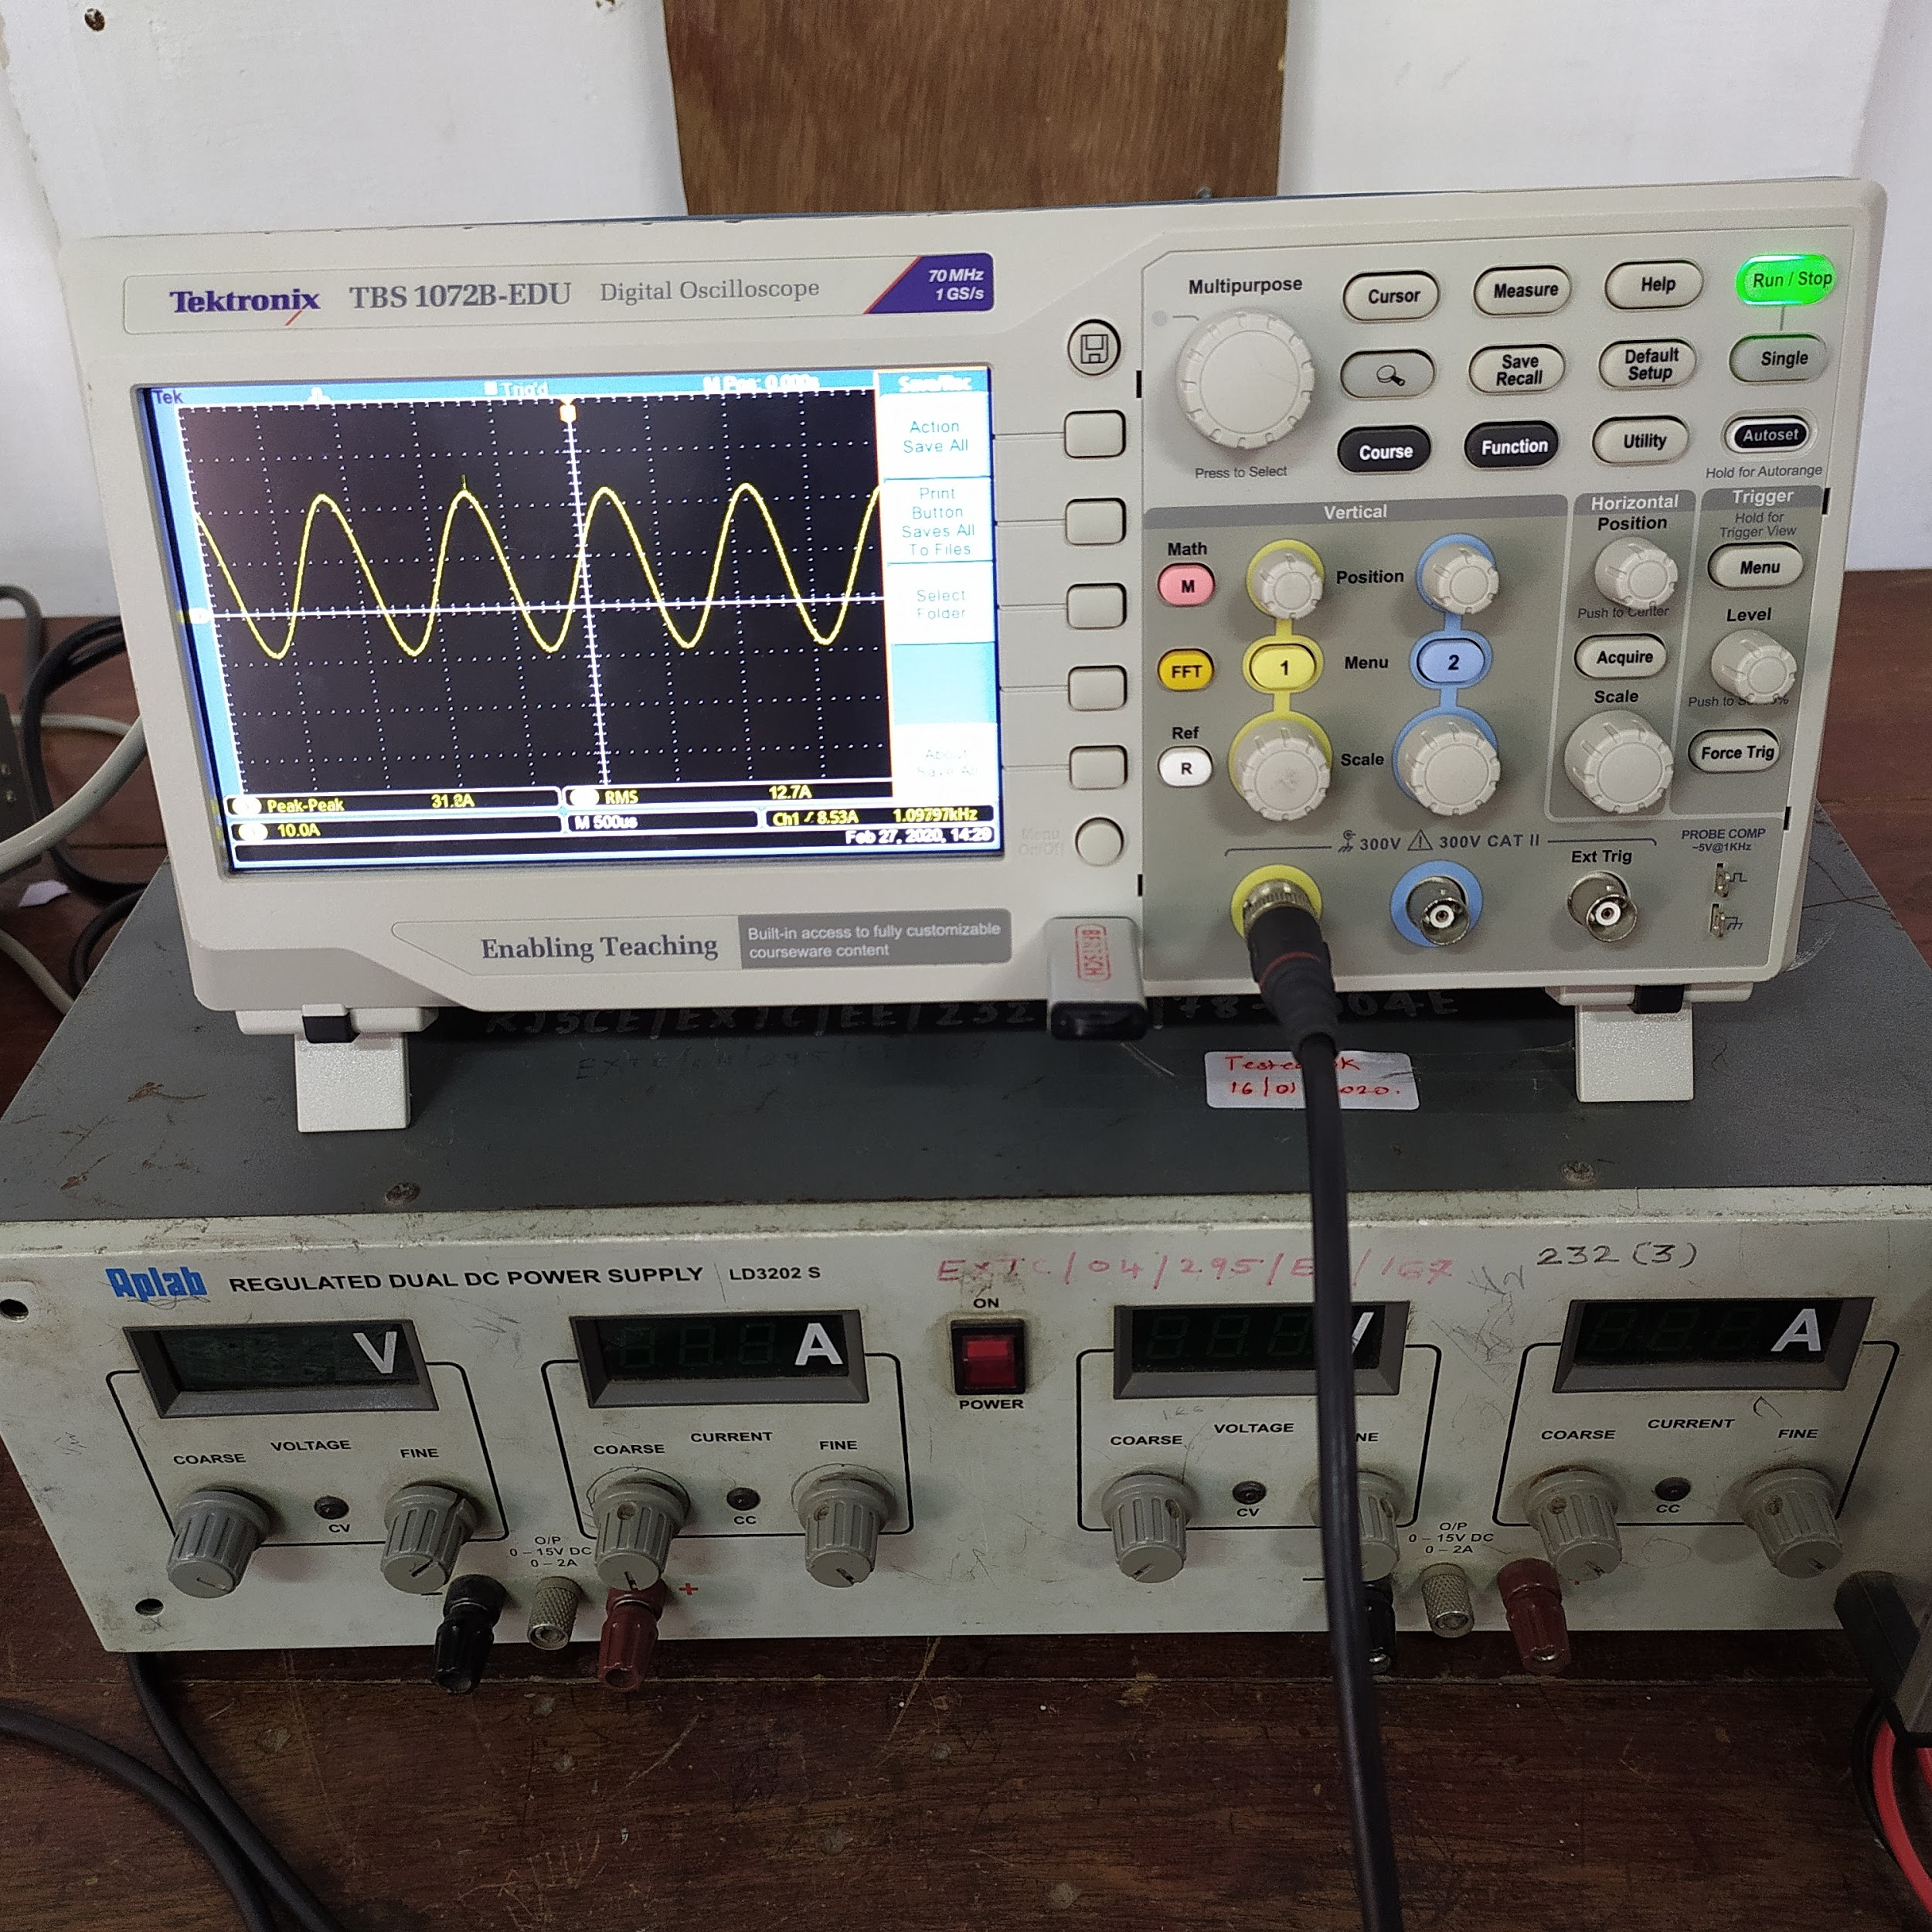
Hardware Implementation

Slide 30
Conclusion
This project would involve the development of routines required for the generation of digitized pulses given the information pertaining to the process that needs to be probed and analyzed.These pulses could in turn be used for testing data acquisition systems and associated signal processing techniques.The algorithm is initialized by a reference pulse shape, with statistical distribution of amplitude and time.

Slide 31
Future Works
Encouraged by the results, the next part we will be performing is implementation of peak amplitude generation of events from a given probability distribution in petalinux environment. After implementing it in petalinux environment,we will interface DAC(Digital to Analog Converter) by using FMC expansion connector to Zync. After this we will generate pulses from DAC and acquire these pulses and plot the analog spectrum.

Slide 32
References
Pramana Journal - https://www.ias.ac.in/Journals/Pramana_%E2%80%93_Journal_of_Physics/
System Design made on: www.draw.io
Paper references - Multichannel Digital Emulator of Radiation Detection Systems, A Fast, Programmable, Stand-Alone Pulse Generator Emulating Spectroscopy Nuclear Events
Tkinter GUI Tool Guide - https://datatofish.com/matplotlib-charts-tkinter-gui/
Matplotlib Guide - https://matplotlib.org/

